Slide 1
Which model predicts a taxi fare best?
MACHINE LEARNING INTERNSHIP · TASK 2
500,000 NYC trips, five models, three cost functions, one saved Pipeline.
Esraa
Notes:
Open with the question. The talk compares five models with three cost functions (MAE, RMSE, R squared) on the same Pipeline and folds, then shows why Gradient Boosting won.

Slide 2
From 500,000 raw trips to the test set
CLEANING AND SPLIT
Raw trips
500,000
5
Dropped 5 incomplete rows
499,995
incomplete rows dropped
Removed impossible values
487,212
12,783
Training set (80%)
389,769
impossible rows removed
Test set (20%)
97,443
213
odd fares removed (train only)
→ Next: the patterns that became features
2
Notes:
Missing values: 5 broken rows, dropped. Impossible values (coordinates outside New York, 0 passengers, fares of 0 or less) were removed before the split. The fare-error rule removed 213 more rows from the training set only, so the test set stays realistic.

Slide 3
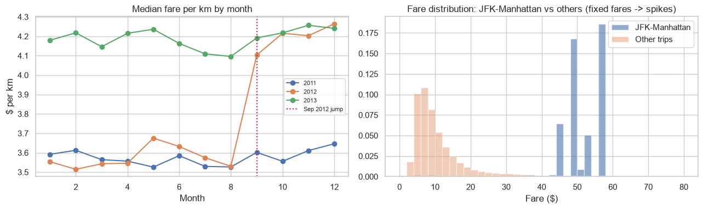
Three patterns in the EDA became features
FEATURES
September 2012
Hour as a circle
JFK to Manhattan
Price per km jumps from about $3.6 to $4.2.
Sine and cosine of the hour.
Fixed fares of about $45-57.
→ Next: how far does a straight line go?
3
Notes:
Left chart: the median fare per km by month. In 2012 the line jumps in September and joins the 2013 level, so the price changed at one moment. Right chart: JFK to Manhattan trips pay a few fixed fares, which a straight line on distance cannot follow.

Slide 4
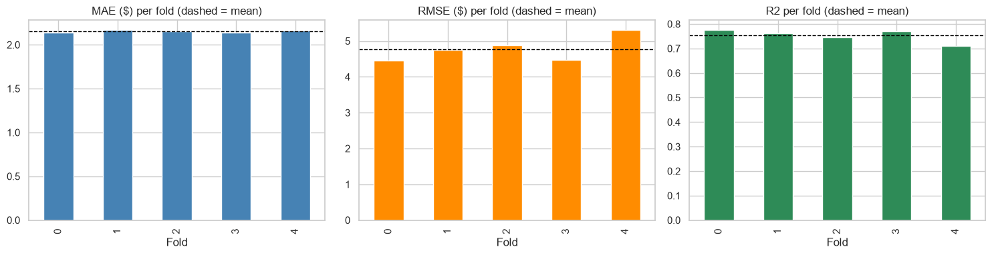
A straight line reaches R² 0.75, and Ridge changes nothing
BASELINE
Baseline cost per fold
Ridge: RMSE for each alpha
4.77
4.77
4.77
4.77
4.77
4.77
0.001
0.01
0.1
1
10
100
0.753
$2.15
$4.77
R², cross-validated
MAE, the typical miss
RMSE, big misses count more
→ Before comparing models: what do the cost functions measure?
4
Notes:
Five-fold cross-validation of Linear Regression on the training data. The error is almost identical on every fold, except fold 4 where the RMSE is higher. Ridge was tuned over six alpha values from 0.001 to 100 and the RMSE barely moved ($4.7730 to $4.7754), so the limit is the model family, not regularization.

Slide 5
How each cost function counts a mistake
COST FUNCTIONS
A $1, $2, $5 and $10 miss counts as...
R²: share of the fare explained
MAE: the miss itself
RMSE: the miss squared
Linear baseline
100
75.2% of the variation explained
Tuned Gradient Boosting
25
1
1
2
4
5
10
83.7% of the variation explained
$1 miss
$2 miss
$5 miss
$10 miss
MAE
RMSE
R²
Average miss in dollars.
Big misses count more.
Higher is better, 1 is perfect.
→ Next: five models, three cost functions
5
Notes:
MAE counts every dollar of error the same. RMSE squares the error, so a $10 miss counts 100 against 1 for a $1 miss. R squared is the share of the fare variation the model explains. All the models in this notebook are trained to minimize squared error on the log of the fare, which is why RMSE is the metric we choose by.

Slide 6
Five models, three cost functions
MODEL COMPARISON
MAE (LOWER IS BETTER)
RMSE (LOWER IS BETTER)
R² (HIGHER IS BETTER)
Gradient Boosting
$1.62
$3.92
0.830
Random Forest
$1.69
$4.04
0.820
Extra Trees
$1.76
$4.11
0.814
Ridge
$2.15
$4.64
0.763
Linear Regression
$2.15
$4.64
0.763
Cross-validated on a 100,000-row sample, same Pipeline and same folds. Gradient Boosting is best on all three.
→ Next: the three finalists on all the training data
6
Notes:
Stage 1 of the benchmark: every candidate runs through the same Pipeline and the same five folds on a 100,000-row sample. Gradient Boosting has the lowest MAE, the lowest RMSE and the highest R squared. Extra Trees and Ridge were screened out; Linear Regression stays as the baseline.

Slide 7
The three finalists on all the training data
MODEL COMPARISON
Linear Regression
Random Forest
Gradient Boosting
RMSE, FULL TRAINING DATA
RMSE, FULL TRAINING DATA
RMSE, FULL TRAINING DATA
$4.77
$4.04
$3.97
FIT TIME PER FOLD
FIT TIME PER FOLD
FIT TIME PER FOLD
9 s
71 s
8 s
BEST WHEN
BEST WHEN
BEST WHEN
the relationship is a straight line and you must explain it.
the data is non-linear and noisy and there is no time to tune.
the data is structured with interactions and fixed prices.
Random Forest is only 1.7% behind, but takes about 10 times longer to train.
→ Is the gain real? A fold-by-fold check
7
Notes:
Stage 2 of the benchmark: the best two models plus the linear baseline, cross-validated on all the training data. Gradient Boosting has the lowest RMSE and trains in 7 seconds per fold against 71 for Random Forest. The fit time is for the whole Pipeline. Each card also says when that model is the best choice.

Slide 8
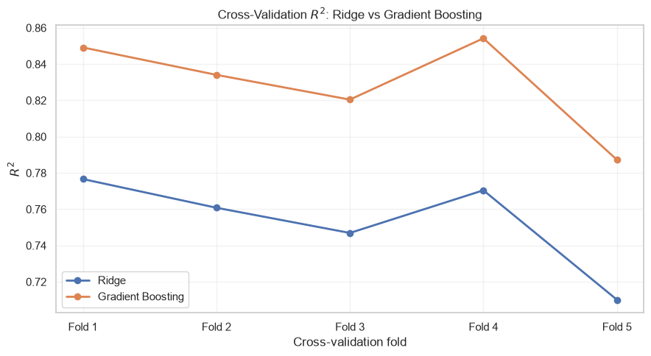
Gradient Boosting wins on every fold
MODEL COMPARISON
5 of 5
folds won
R² GAINED PER FOLD
Fold 1
+0.0725
Fold 2
+0.0733
Fold 3
+0.0735
Fold 4
+0.0838
Fold 5
+0.0772
Paired t-test: t = 36.36 (only a hint, the folds share data).
→ Can tuning improve it?
8
Notes:
The same five folds validate both models, so the comparison is paired. Gradient Boosting wins on all five, with a gain between 0.07 and 0.08 R squared. Skipping the SelectKBest feature selector helped it: RMSE 3.97 without it against 4.05 with it.

Slide 9
Most of the gain came from the model, not the tuning
TUNING
Test RMSE at each step
Best settings found
learning rate 0.1
$4.76
-18.1%
-0.9%
$3.90
500 rounds
$3.87
31 leaves per tree
smallest leaf 50 rows
10 of 108 combinations tried.
Linear baseline
Gradient Boosting
After tuning
→ The final comparison on the test set
9
Notes:
Only the winner is tuned, with a random search of 10 out of 108 combinations on the same folds. Changing from the linear baseline to Gradient Boosting cut the test RMSE by 18.1 percent. Tuning added another 0.9 percent, from 3.8997 to 3.8650.

Slide 10
Baseline vs tuned model, on the test set
THE RESULT
MAE ($)
RMSE ($)
R²
2.15
4.76
0.837
0.752
1.54
3.87
Baseline
Final
Baseline
Final
Baseline
Final
+0.085
-28.5%
-18.8%
→ The cost functions do not improve by the same amount
10
Notes:
This is the short results table the task asks for, shown as bars: baseline (Linear Regression) against the final tuned Gradient Boosting, scored once on the held-out test set of 97,443 trips. MAE 2.1537 to 1.5390, RMSE 4.7608 to 3.8650, R squared 0.7521 to 0.8366.

Slide 11
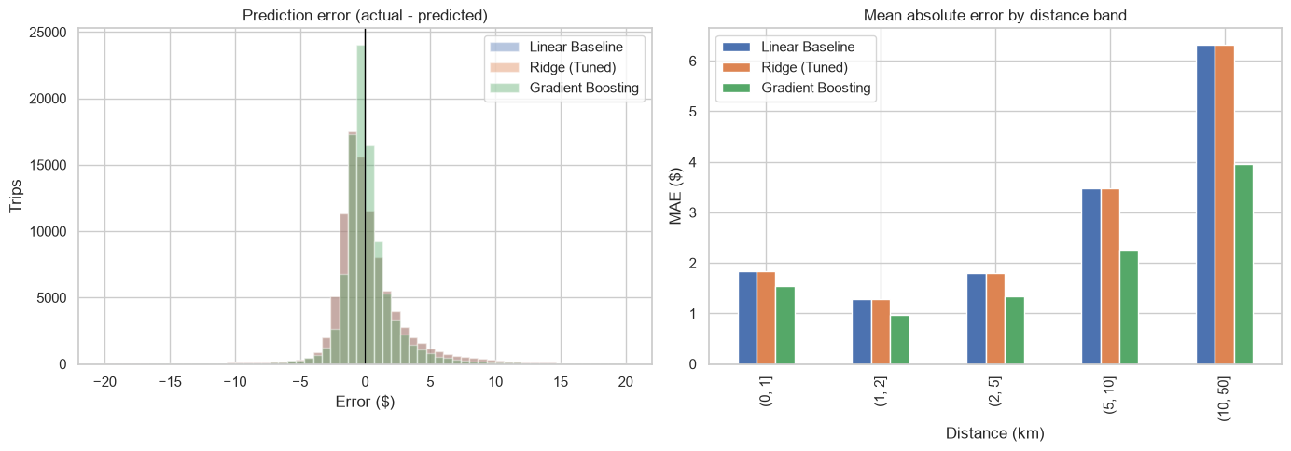
Big misses shrink less than the average miss
COST FUNCTIONS
Error distribution and MAE by trip length
REDUCTION ON THE TEST SET
MAE
-28.5%
RMSE
-18.8%
RMSE DIVIDED BY MAE
2.21
2.51
to
A larger ratio means what is left is mostly a few big misses.
→ Where does the model help most?
11
Notes:
MAE falls by 28.5 percent but RMSE only by 18.8 percent. RMSE divided by MAE rises from 2.21 to 2.51, so the remaining error is dominated by a few large misses. The figure shows the error histograms of the baseline, Ridge and Gradient Boosting, and the MAE by trip length: the long trips are where the largest errors are.

Slide 12
Long trips gain the most
WHERE IT HELPS
Average error by trip length
Trips predicted close to the real fare
Linear baseline
Gradient Boosting
within $2
$6.33
71%
81%
within $3
$3.95
84%
$3.47
89%
$1.85
$2.25
within $5
$1.54
$1.80
$1.28
$0.97
$1.34
92%
95%
Typical (median) error: $1.22 to $0.82.
0-1 km
1-2 km
2-5 km
5-10 km
10-50 km
→ Is the gain bigger than the noise?
12
Notes:
Left: the average error by trip length on the test set, linear baseline against Gradient Boosting before tuning. On trips over 10 km the error falls from 6.33 to 3.95 dollars. Right: the share of test trips predicted within 2, 3 and 5 dollars of the real fare, baseline against the final model.

Slide 13
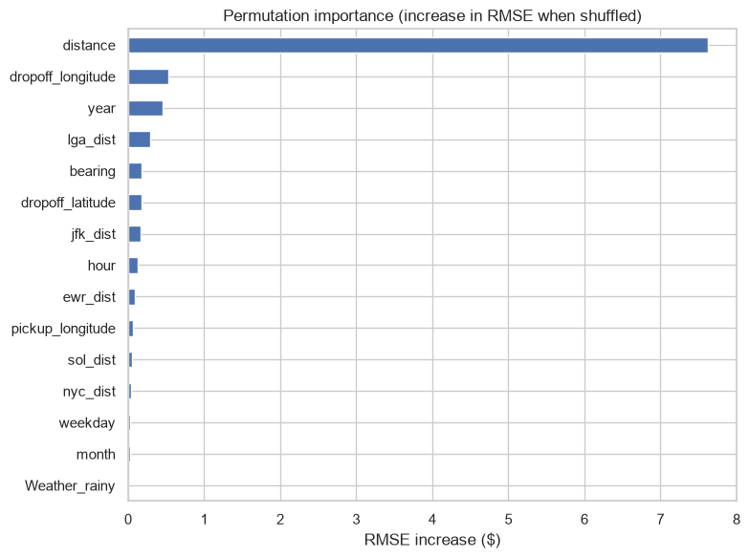
The gain is bigger than the noise
CHECKS
RMSE with a 95% bootstrap interval
What the model relies on
Linear baseline
$4.44
$5.20
Tuned Gradient Boosting
$3.51
$4.30
The intervals do not overlap. Saved file: 1.4 MB, 0.11 s per 10,000 trips.
→ What I would try next
13
Notes:
The bootstrap resamples the test trips 300 times. The intervals of the baseline and the final model do not overlap. The saved Pipeline is one file of 1.4 megabytes and predicts 10,000 trips in about a tenth of a second. Permutation importance shows that distance dominates.

Slide 14
What I would try next
NEXT STEPS
Encoding inside the Pipeline
A smarter search
So the saved file accepts a raw row.
Optuna, and Ridge stacked with the best tree model.
Where it still fails
A time-based split
SHAP on fixed airport fares and trips over 10 km.
The September 2012 price change may affect later trips.
Explore the models yourself: open the interactive model explorer
14
Notes:
Closing: the first improvement is to move the encoding into the Pipeline so the saved file accepts a raw row. The others are a smarter search, an explanation of the remaining errors, and a time-based check.

